Slide 1




ASP.NET Core Essentials
Routing, Controllers, Request, Response, Razor, DI
C# MVC Frameworks
SoftUni Team
Technical Trainers
Software University
http://softuni.bg

Slide 2



Table of Contents

Slide 3
Questions
sli.do #csharp-web

Slide 4
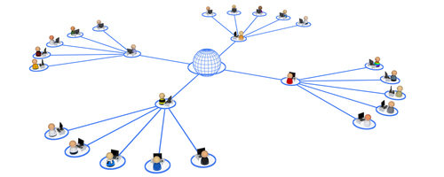
ASP.NET Core MVC Routing

Slide 5
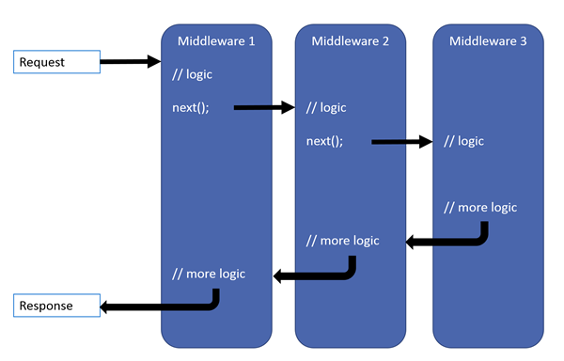

ASP.NET Core MVC Routing
ASP.NET Core MVC uses a middleware for Routing on client requests.
Routes describe how request URL paths should be mapped to Controller actions.
There are 2 types of Action routing
Conventional
Attribute

Slide 6

Conventional & Attribute Routing

Slide 7
Conventional Routing
Called conventional because it establishes a convention for URL paths.
public void Configure(IApplicationBuilder app, IHostingEnvironment env)
{
app.UseMvc(routes =>
{
routes.MapRoute(
name: "default",
template: "{controller=Home}/{action=Index}/{id?}");
});
}
Will match a route like “/Cats/Show/1”.
Will extract the route values:
{ controller = Cats, action = Show, id = 1 }

Slide 8
Conventional Routing
Using Conventional Routing, with the default route:
Optimizes an application by preventing the creation of a new URL pattern for every Action.
Ensures URL consistency in CRUD style applications.
Simplifies code and makes the UI more predictable.
Can also be implemented like this:
public void Configure(IApplicationBuilder app, IHostingEnvironment env)
{
app.UseMvcWithDefaultRoute();
}

Slide 9
Attribute Routing
Attribute routing uses a set of attributes to map actions directly to route templates.
public void Configure(IApplicationBuilder app, IHostingEnvironment env)
{
app.UseMvc();
}
Empty method call
public class HomeController : Controller
{
[Route("/")]
public IActionResult Index()
{
return View();
}
}

Slide 10
Attribute Routing
Attribute routing can also directly define the Method.
public class HomeController : Controller
{
//...
[HttpGet("/")]
public IActionResult Index()
{
return View();
}
}
public class UsersController : Controller
{
//...
[HttpPost("/")]
public IActionResult Login()
{
return View();
}
}
Http*action* attributes are quite often used in REST APIs.

Slide 11
Attribute Routing
Attribute routing allows you to route create multiple routes for a single action.
It also allows you to combine a Route for a controller and an action Route.
public class HomeController : Controller
{
//...
[Route("/")]
[Route("Index")]
public IActionResult Index()
{
return View();
}
}
[Route("Home")]
public class HomeController : Controller
{
//...
[Route("/")] // Does not combine, Route – /
[Route("Index")] // Route - /Home/Index
[Route("")] // Route - /Home
public IActionResult Index()
{
return View();
}
}

Slide 12
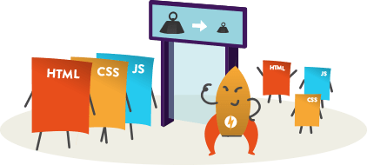
Static File Routing

Slide 13
Static Files
Static files are a necessity for a web application to work.
Files such as HTML, CSS, JS, and different Assets can be served directly to Clients with ASP.NET Core
public void Configure(IApplicationBuilder app, IHostingEnvironment env)
{
app.UseStaticFiles();
}
This will tell the ASP.NET Core app to serve the static files in the wwwroot directory.

Slide 14
Static Files
Can be modified to serve other folders.
public void Configure(IApplicationBuilder app, IHostingEnvironment env)
{
app.UseStaticFiles(); // For the wwwroot folder
app.UseStaticFiles(new StaticFileOptions()
{
FileProvider = new PhysicalFileProvider(
Path.Combine(Directory.GetCurrentDirectory(), @"OtherFiles")),
RequestPath = new PathString("/files")
});
}
Folder in Project
This will serve “style.css” file upon request “http://{app}/files/style.css”

Slide 15

ASP.NET Core MVC Controllers

Slide 16

ASP.NET Core MVC Controller
A Controller is used to define and group a set of actions.
An Action is a method on a Controller which handles requests.
By convention, Controllers:
Are put in the Controllers folder.
Inherit from the Base ASP.NET Core Controller class.
Their class name is suffixed with “Controller”.
They inherit from a class with class name suffixed with “Controller”
They are decorated with the [Controller] attribute (Optional).

Slide 17
Controller Essentials
The Base Controller class provides a lot of functionality
View() method – One of the most frequently used Controller class members
public IActionResult Index()
{
return View();
}
public IActionResult Index()
{
return View(UserModel);
}
public IActionResult Index()
{
return View("Register");
}
public IActionResult Index()
{
return View("Register", UserModel);
}

Slide 18
Controller Essentials
Other frequently used methods and Controller class members
Redirect() method – Redirects to a specified action
ViewBag member – Provides use of Weekly-typed data for the Views.
ViewData member – Again Weekly-typed data but in the form of a Dictionary with <string, dynamic> key-value pairs.
ModelState member – Provides access to the state of the Model and the Model-binding validation.
User member – Provides info for the User associated with the current Action call.
HttpContext member – Provides access to the HTTP data (Request, Response, etc.) for the currently executing action

Slide 19

Razor View Engine

Slide 20
Views
HTML templates of the application
A lot of view engines available
View engines execute code and provide HTML
Provide a lot of helpers to easily generate HTML
The most popular is Razor View Engine
We can pass data to views through:
ViewBag, ViewData and Model (strongly-typed views)

Slide 21

Razor
Template markup syntax
Simple-syntax view engine
Based on the C# programming language
Enables the programmer to use an HTML construction workflow
Code-focused templating approach, with minimal transition between HTML and code
Razor syntax starts code blocks with a @ character and does not require explicit closing of the code-block

Slide 22
Passing Data to a View
With ViewBag (dynamic type):
Action: ViewBag.Message = "Hello World!";
View: @ViewBag.Message
With ViewData (dictionary)
Action: ViewData["message"] = "Hello World!";
View: @ViewData["message"]
With Strongly-typed views:
Action: return View(model);
View: @model ModelDataType;

Slide 23


Summary
ASP.NET Core Routing
Conventional
Attribute
ASP.NET Core MVC Controllers
Essentials
Razor View Engine
Passing data to the Views

Slide 24







C# MVC Frameworks – Course Overview
https://softuni.bg/courses/asp-net-mvc

Slide 25
License
This course (slides, examples, demos, videos, homework, etc.) is licensed under the "Creative Commons Attribution-NonCommercial-ShareAlike 4.0 International" license

Slide 26





Trainings @ Software University (SoftUni)
Software University – High-Quality Education, Profession and Job for Software Developers
softuni.bg
Software University Foundation
http://softuni.foundation/
Software University @ Facebook
facebook.com/SoftwareUniversity
Software University Forums
forum.softuni.bg

